Slide 1

E-State
FYP-II
Obaid Ismail (190892)
Muhammad Umar Akhtar (190924)
Aamir Yasin (190928)
Intro
Supervisor
Main
Supervised by:
Hafiz Muhammad
Ahsan Shehzad

Slide 2

E-State
Ghar se Ghar lo
Supervisor
E-commerce web application in which users can buy and sell real estate.
Web tool through which users can experience virtual tour.
Payment through Credit/Debit Card.
Intro
Main

Slide 3
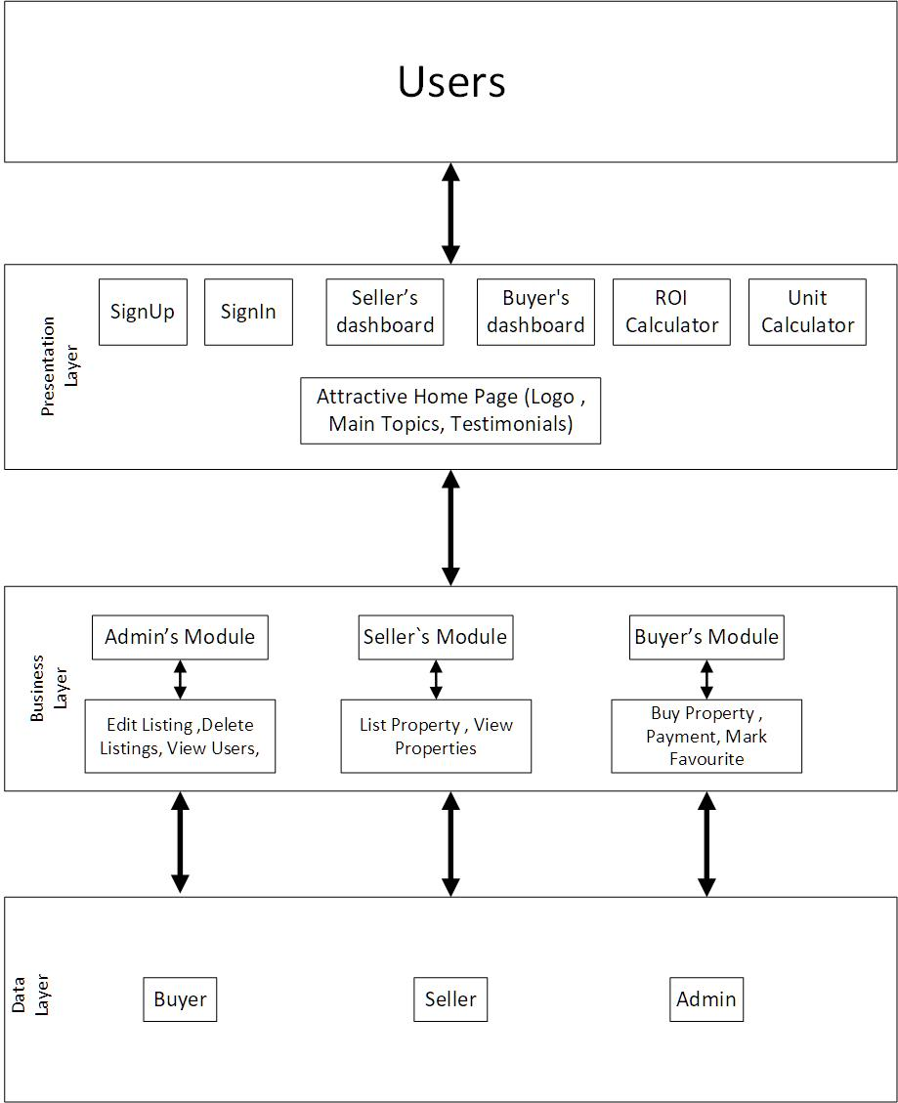

Architecture Diagram:
Supervisor
Intro
Main

Slide 4
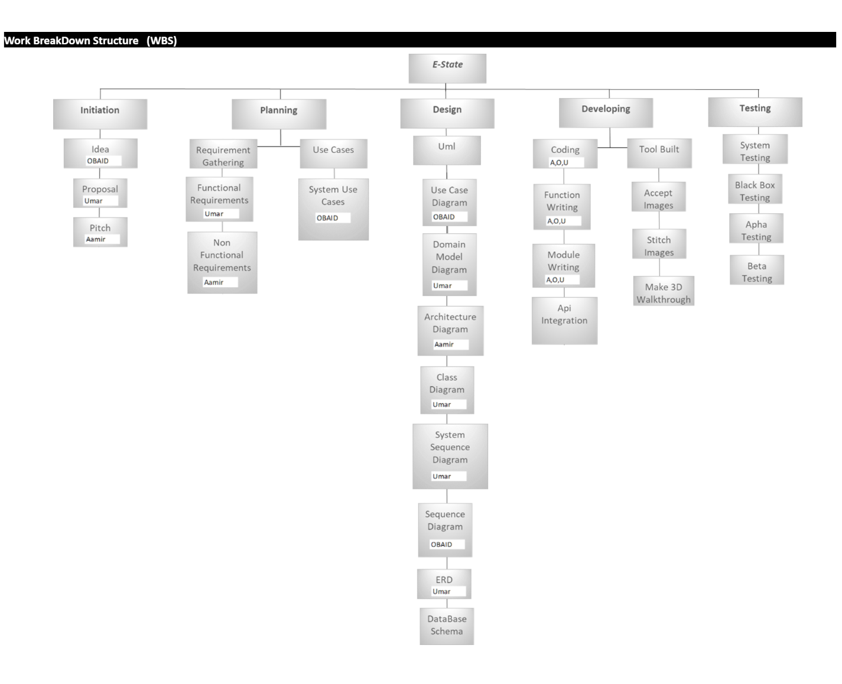
Project Work Break Down:
Supervisor
Intro
Main

Slide 5
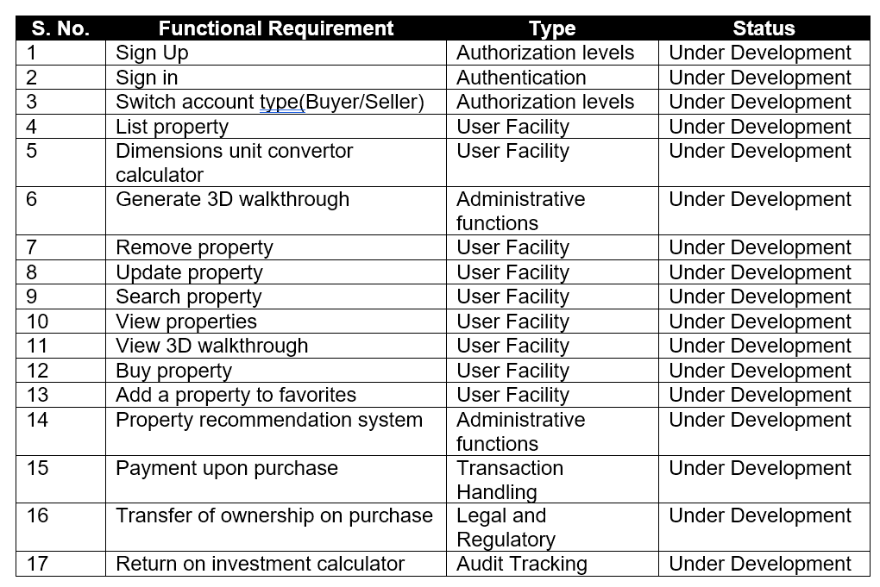
Functional Requirements:
teams
Supervisor
Intro
Main

Slide 6
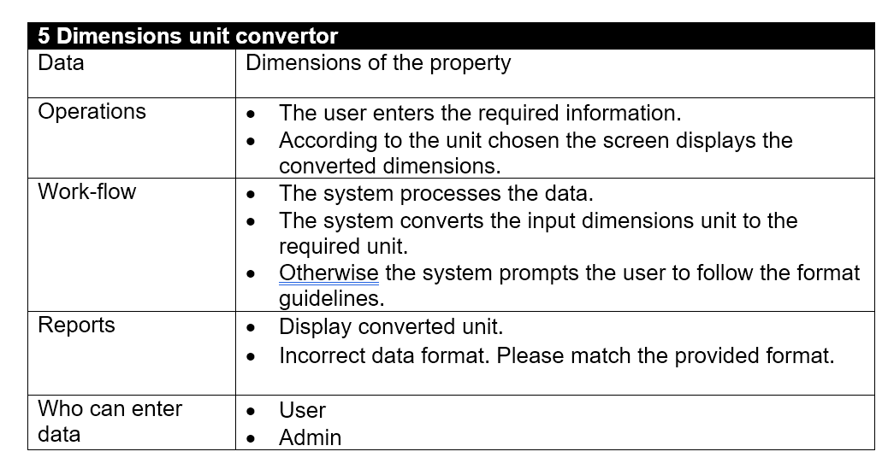
Functional Requirement:
Supervisor
Intro
Main

Slide 7
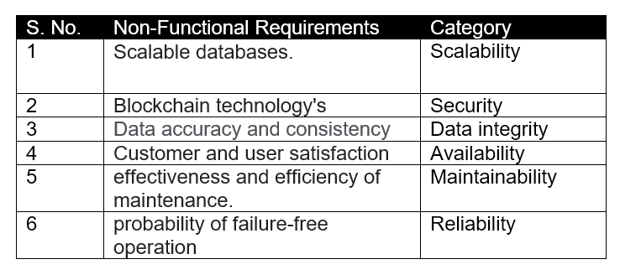
Non-Functional Requirements:
Supervisor
Intro
Main

Slide 8
Use Case Diagram :
Supervisor
Intro
Main

Slide 9
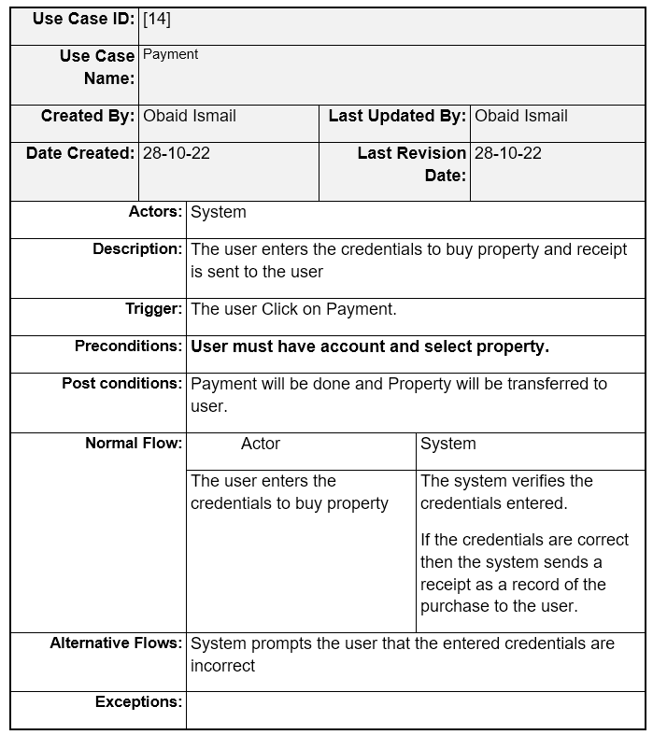
Fully Dressed
Use Case :
Supervisor
Intro
Main

Slide 10
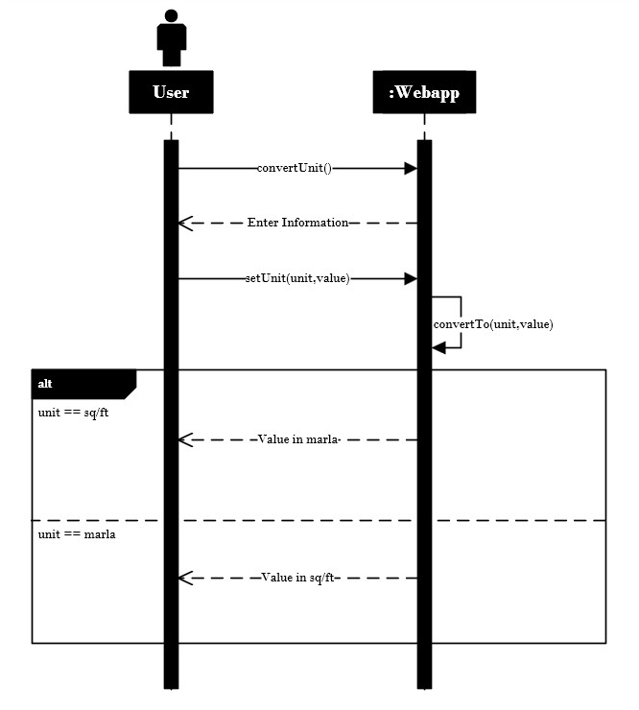
System Sequence
Diagram [5]:
Supervisor
Intro
Main

Slide 11
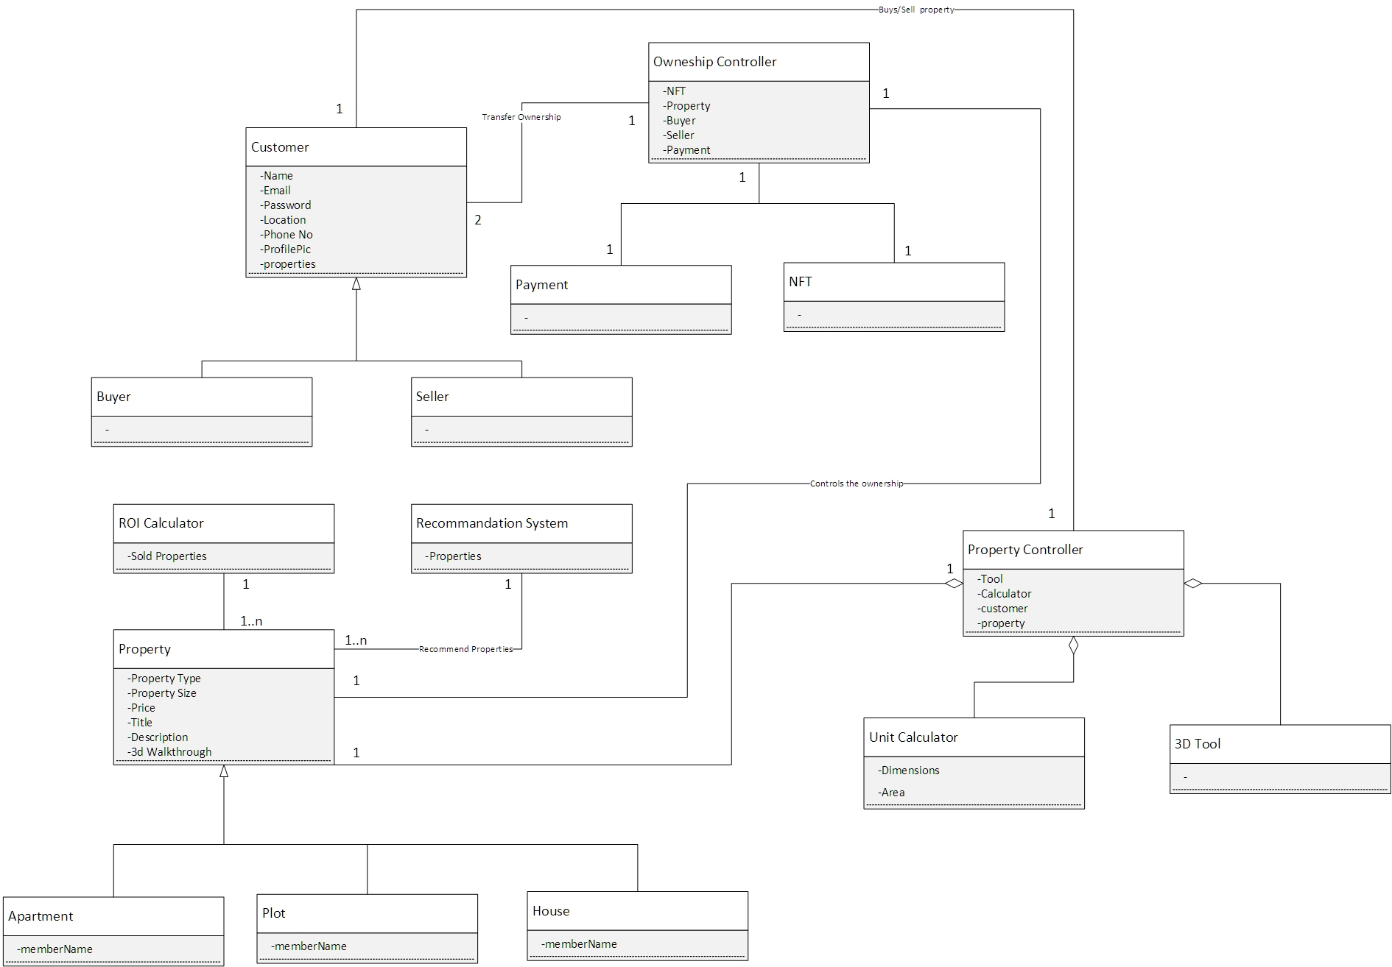
Domain Model:
Supervisor
Intro
Main

Slide 12
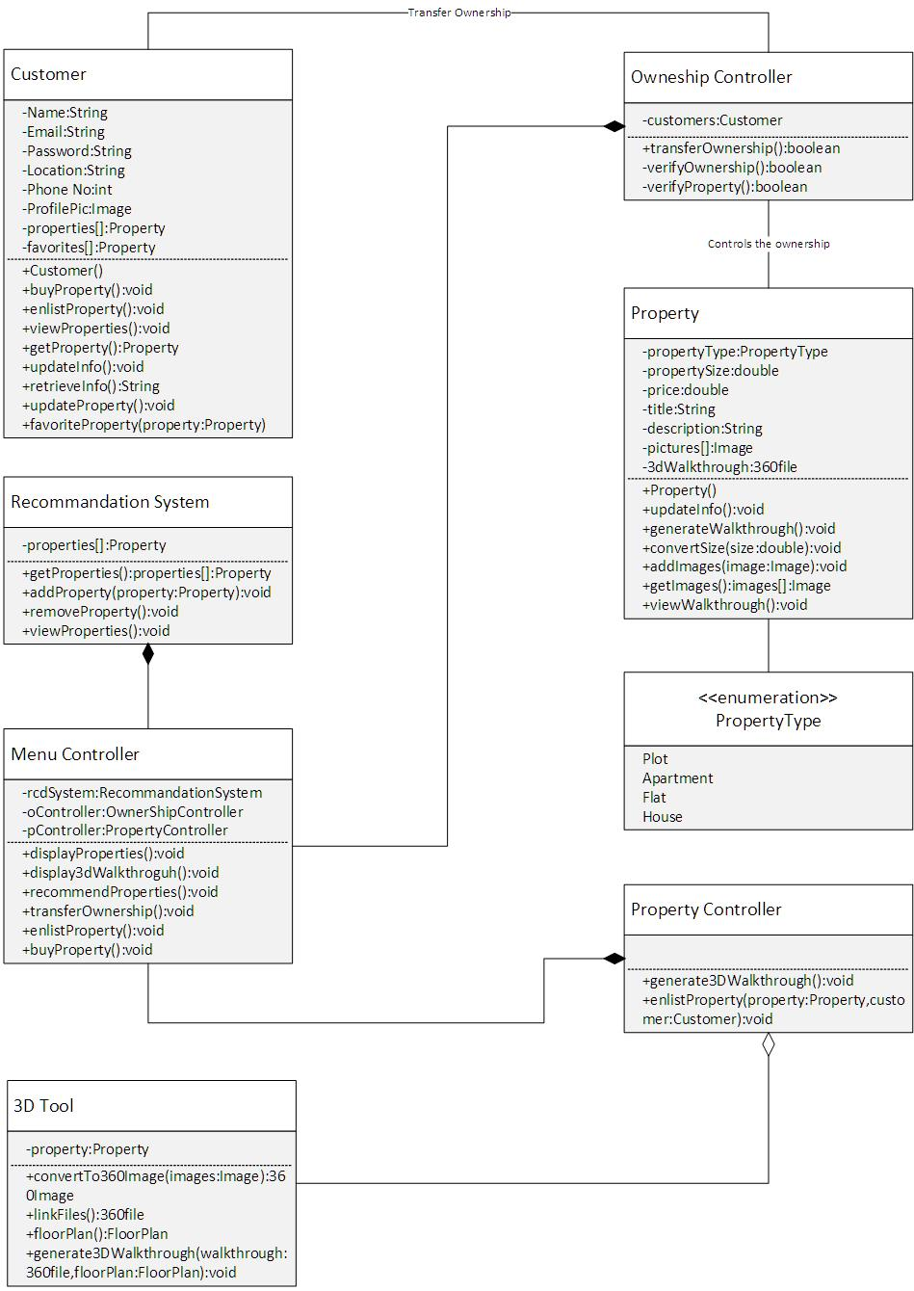
Class Diagram:
Supervisor
Intro
Main

Slide 13
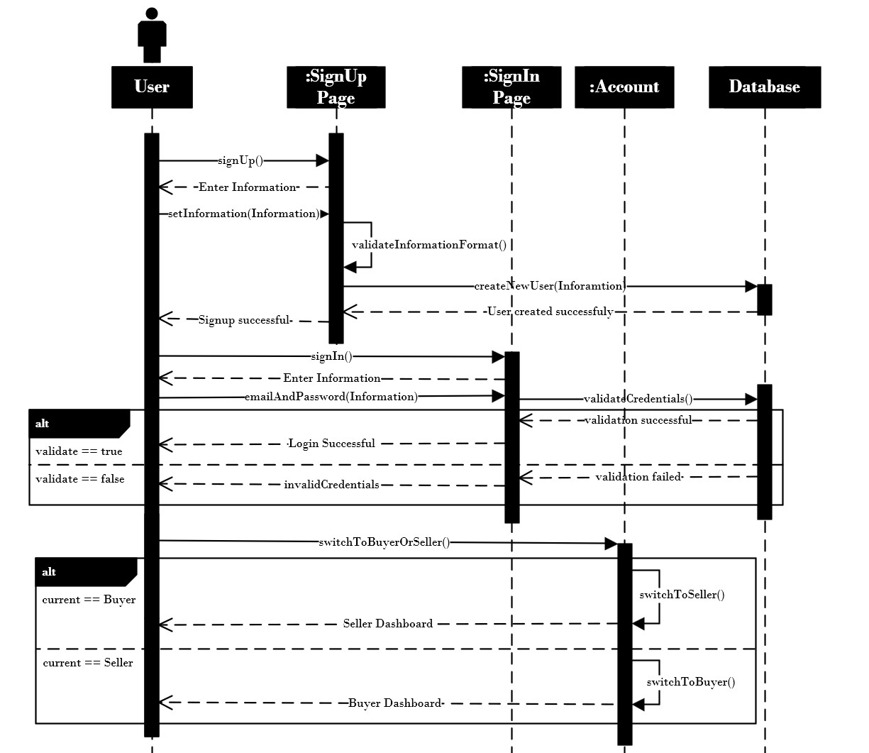
Sequence Diagram:
Supervisor
Intro
Main

Slide 14
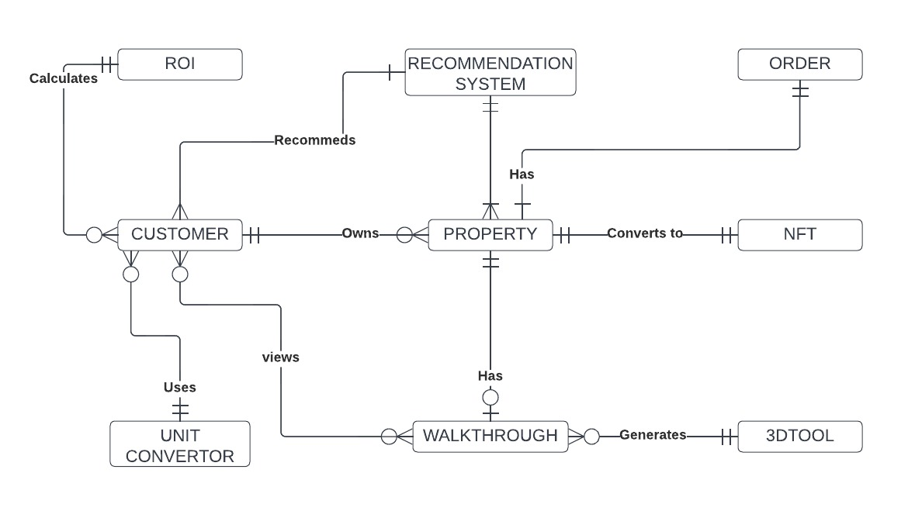
Entity Relationship Diagram:
Supervisor
Intro
Main

Slide 15
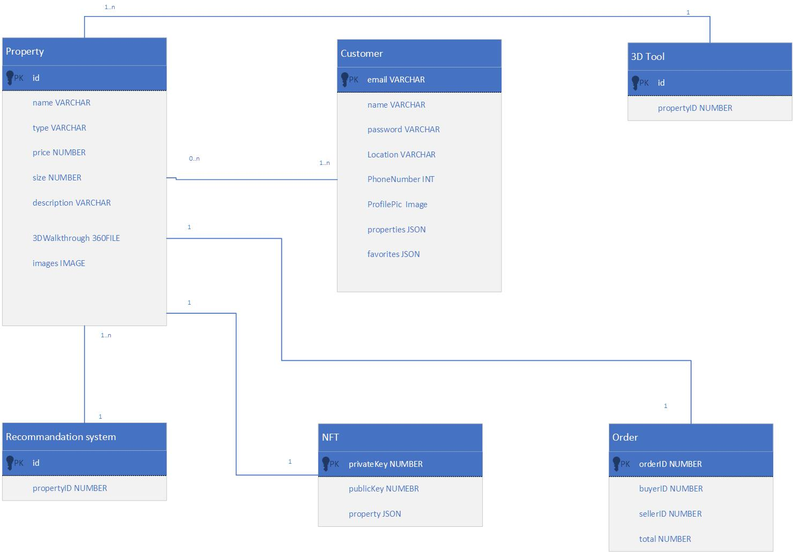
DataBase Schema:
Supervisor
Intro
Main

Slide 16
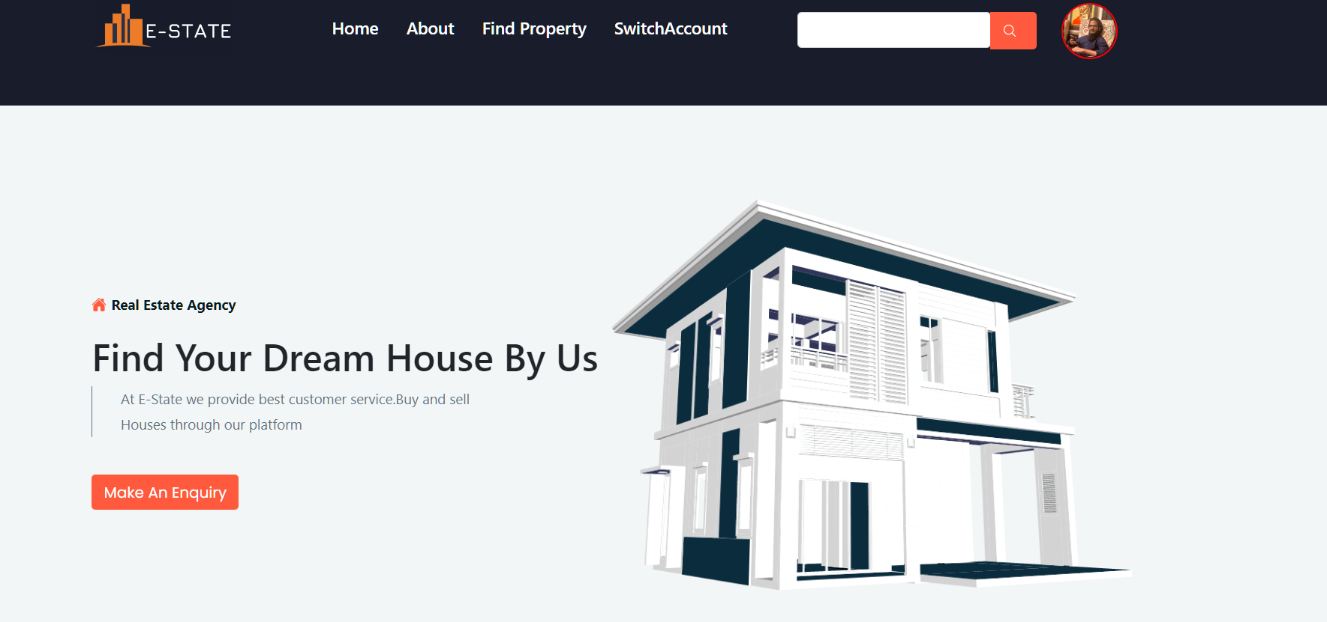
Home Page:
Supervisor
Intro
Main

Slide 17
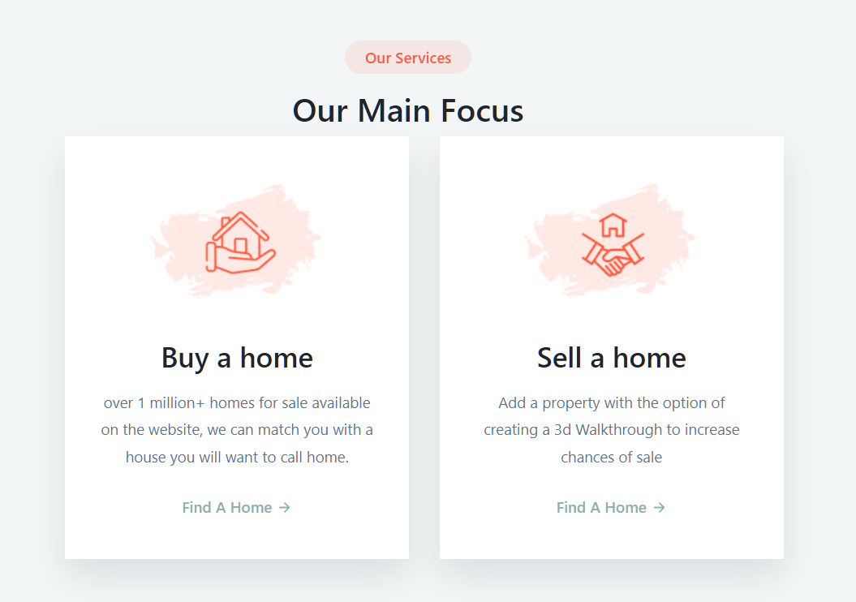
Main Focus:
Supervisor
Intro
Main

Slide 18
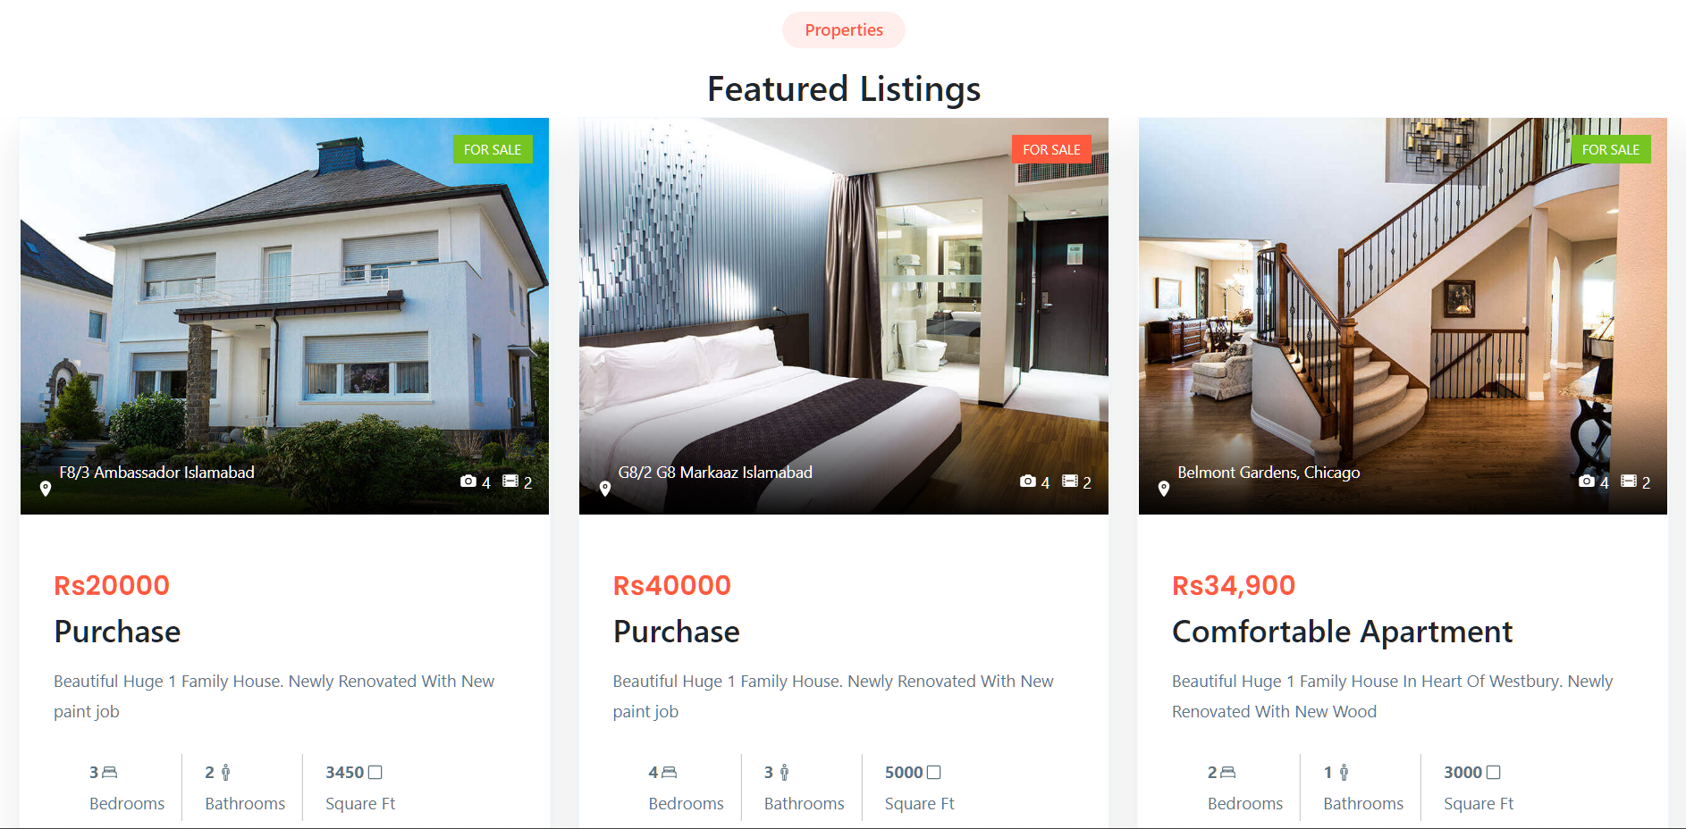
Featured listings:
Supervisor
Intro
Main

Slide 19
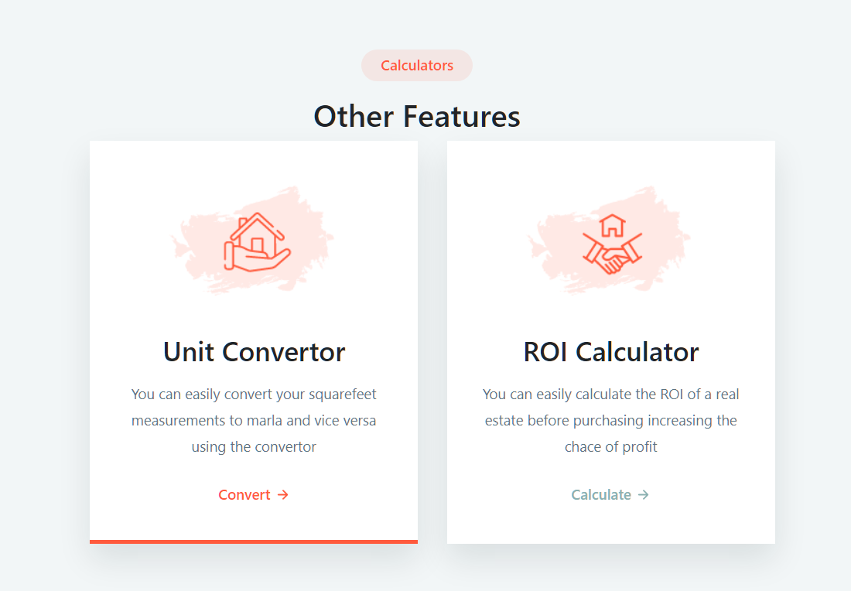
Calculators:
Supervisor
Intro
Main

Slide 20
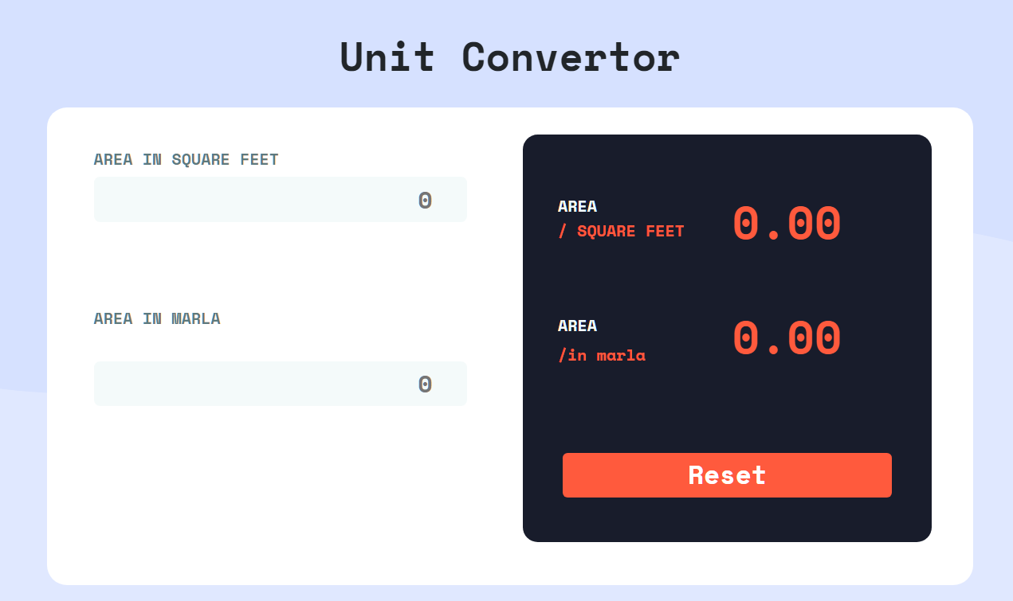
Unit Converter:
Supervisor
Intro
Main

Slide 21
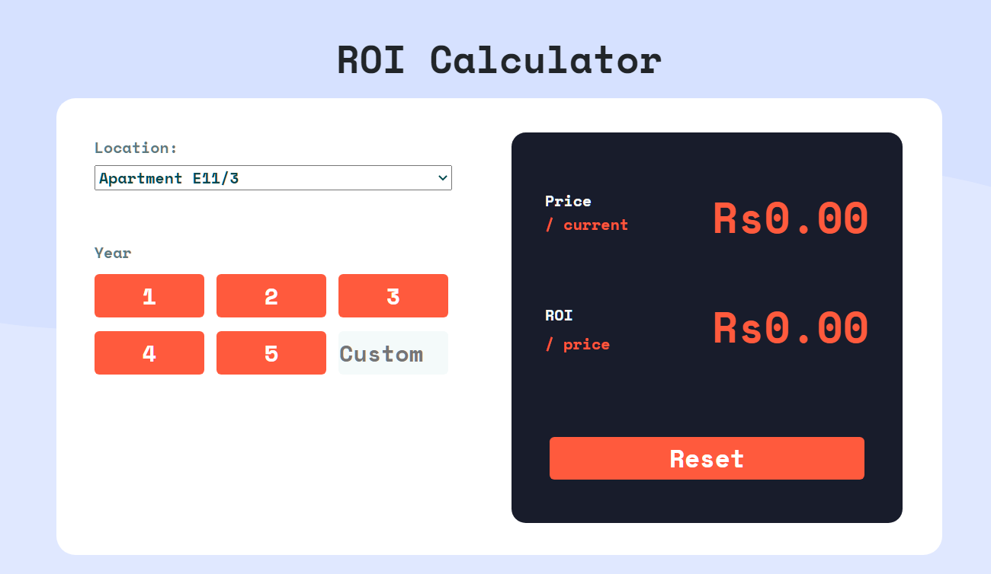
ROI Calculator:
Supervisor
Intro
Main

Slide 22
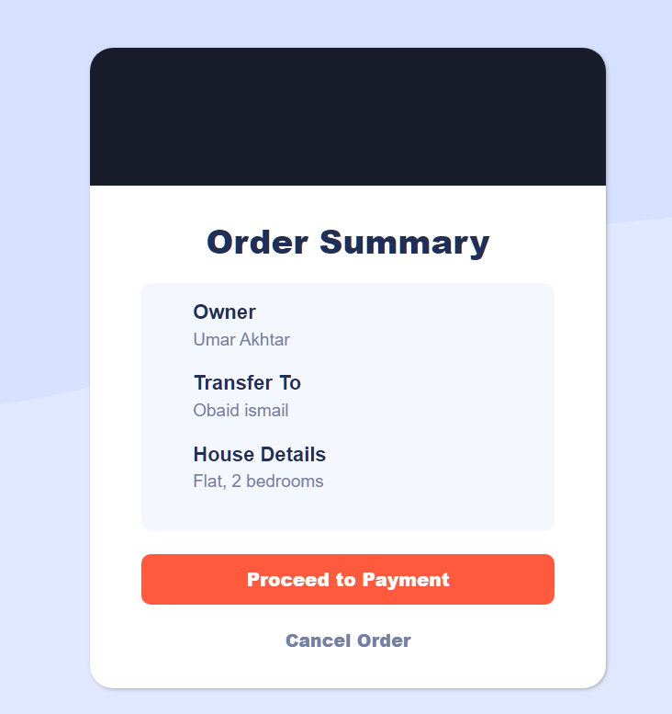
Order Summary:
Supervisor
Intro
Main

Slide 23
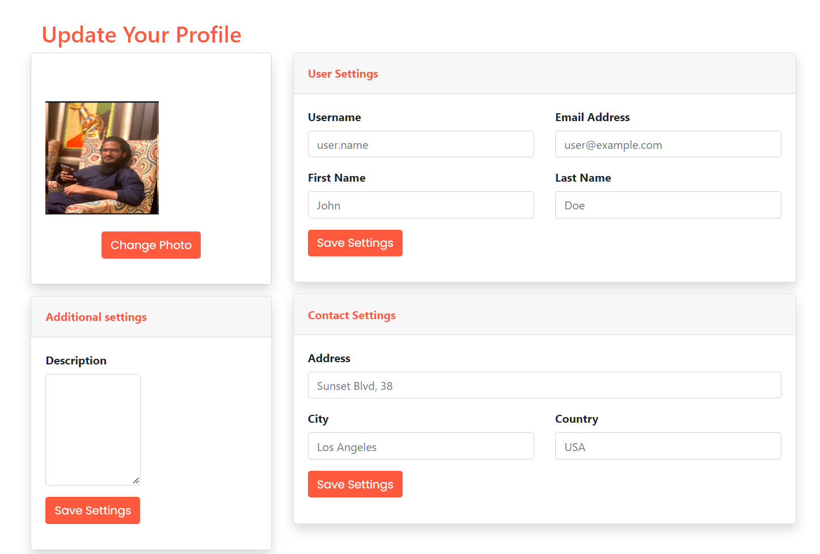
Payment Page:
Supervisor
Intro
Main

Slide 24
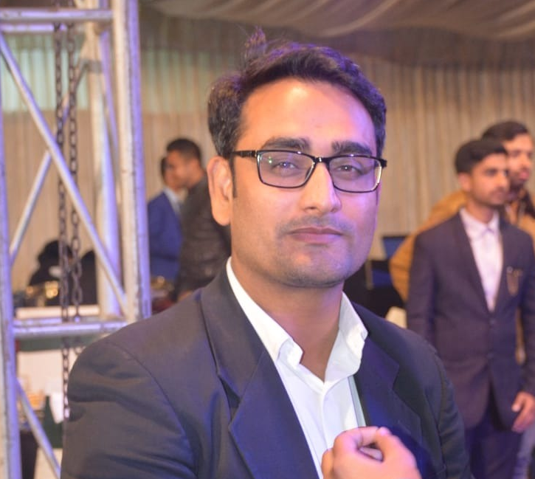
E-State
Intro
Supervisor
Main
Hafiz Muhammad
Ahsan Shehzad

Slide 25

Intro
Supervisor
Main

